Slide 1
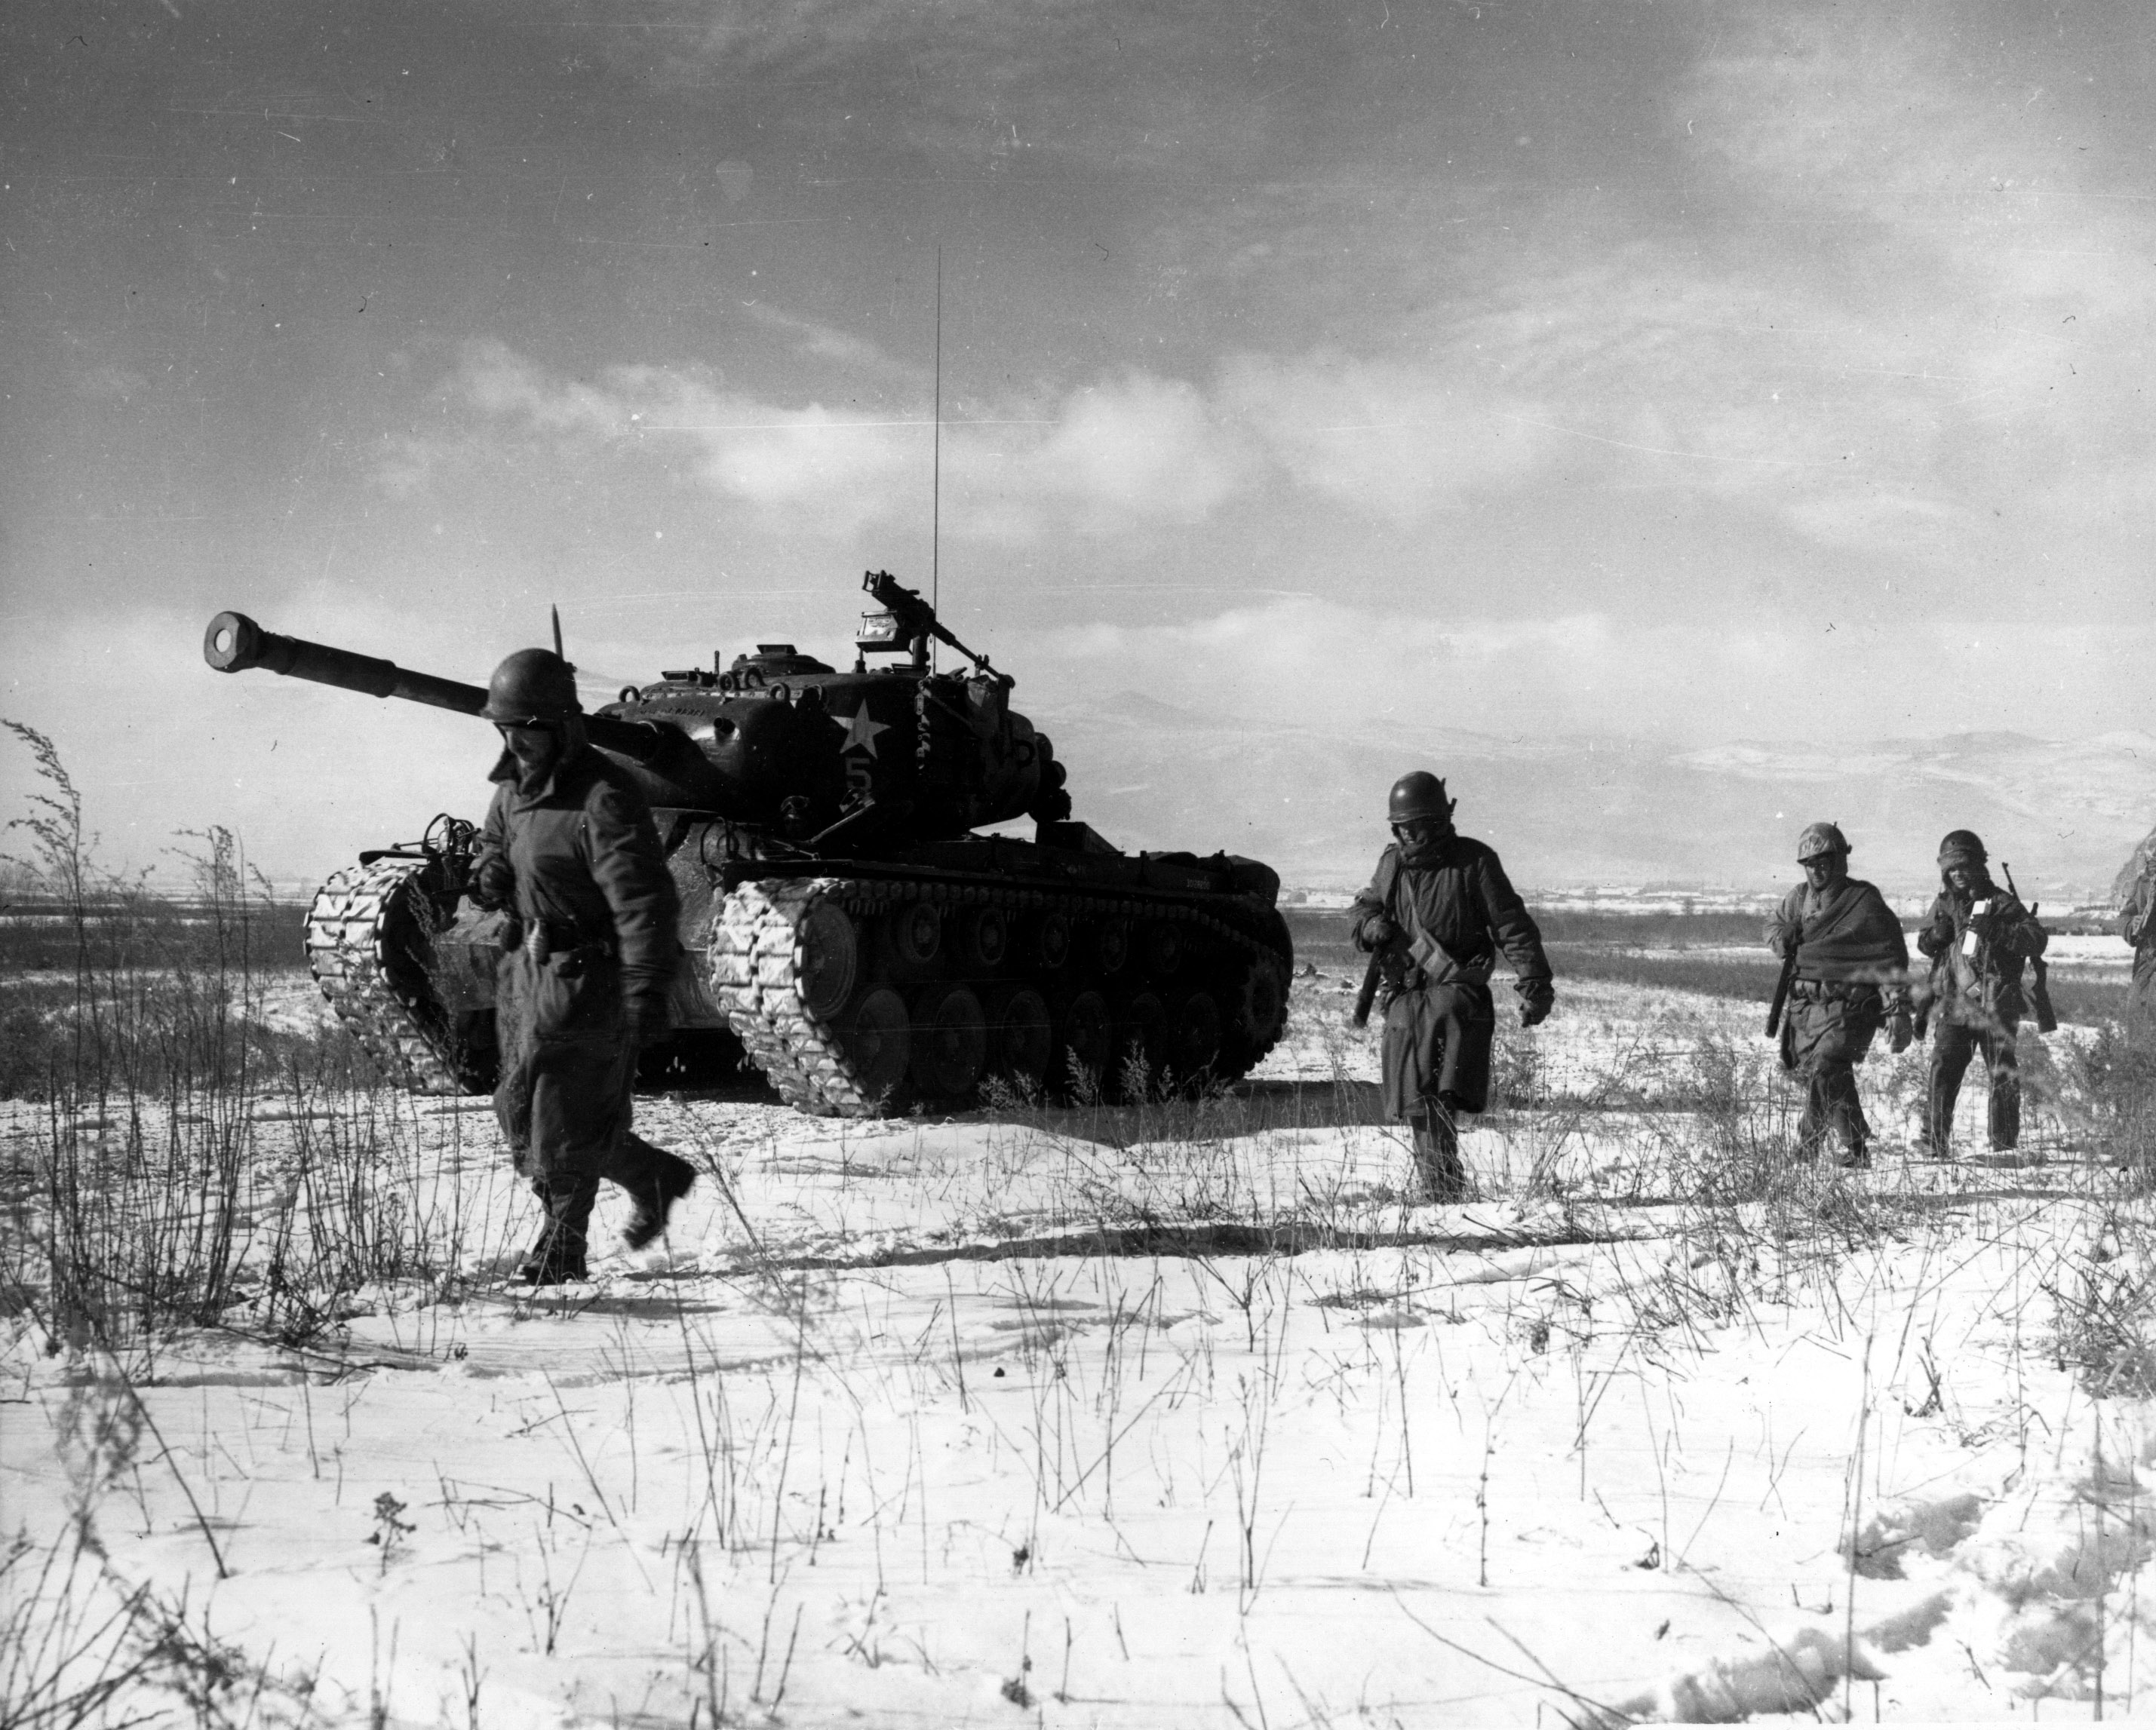
Orientation
Pusan, August 4 to September 18, 1950: a large-scale battle between United Nations
and North Korean forces. Last Stand for United Nations
Inchon, September 15-19, 1950: Operation Chromite an amphibious invasion led by General MacArthur
Chosin, 27 November - 13 December 1950: UN troops nicknamed "The Chosin Few“ led by Major General Edward Almond ,were surrounded by 67,000 Chinese troops.

Slide 2

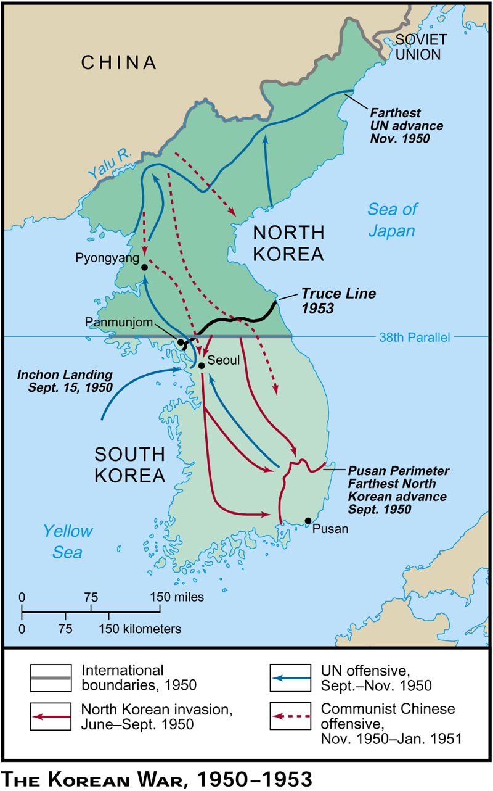
Geography
Pusan, August 4 to September 18, 1950: a large-scale battle between United Nations
and North Korean forces
Inchon, September 15-19, 1950: Operation Chromite an amphibious invasion led by General MacArthur
Chosin, 27 November - 13 December 1950: UN troops nicknamed "The Chosin Few“ led by Major General Edward Almond ,were surrounded by 67,000 Chinese troops.

Slide 3
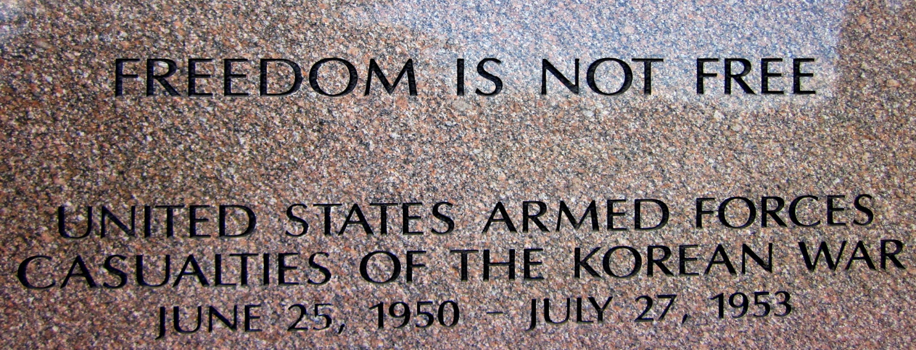
The Korean War
"In my generation, this was not the first occasion when the strong had attacked the weak….Communism was acting in Korea just as Hitler, Mussolini, and the Japanese had acted ten, fifteen, and twenty years earlier. I felt certain that if South Korea was allowed to fall, Communist leaders would be emboldened to override nations closer to our own shores." - President Harry Truman
"They're on our right, they're on our left, they're in front of us, they're behind us; they can't get away from us this time."
-Chesty Puller, USMC, Chosin Reservoir, Korean War

Slide 4
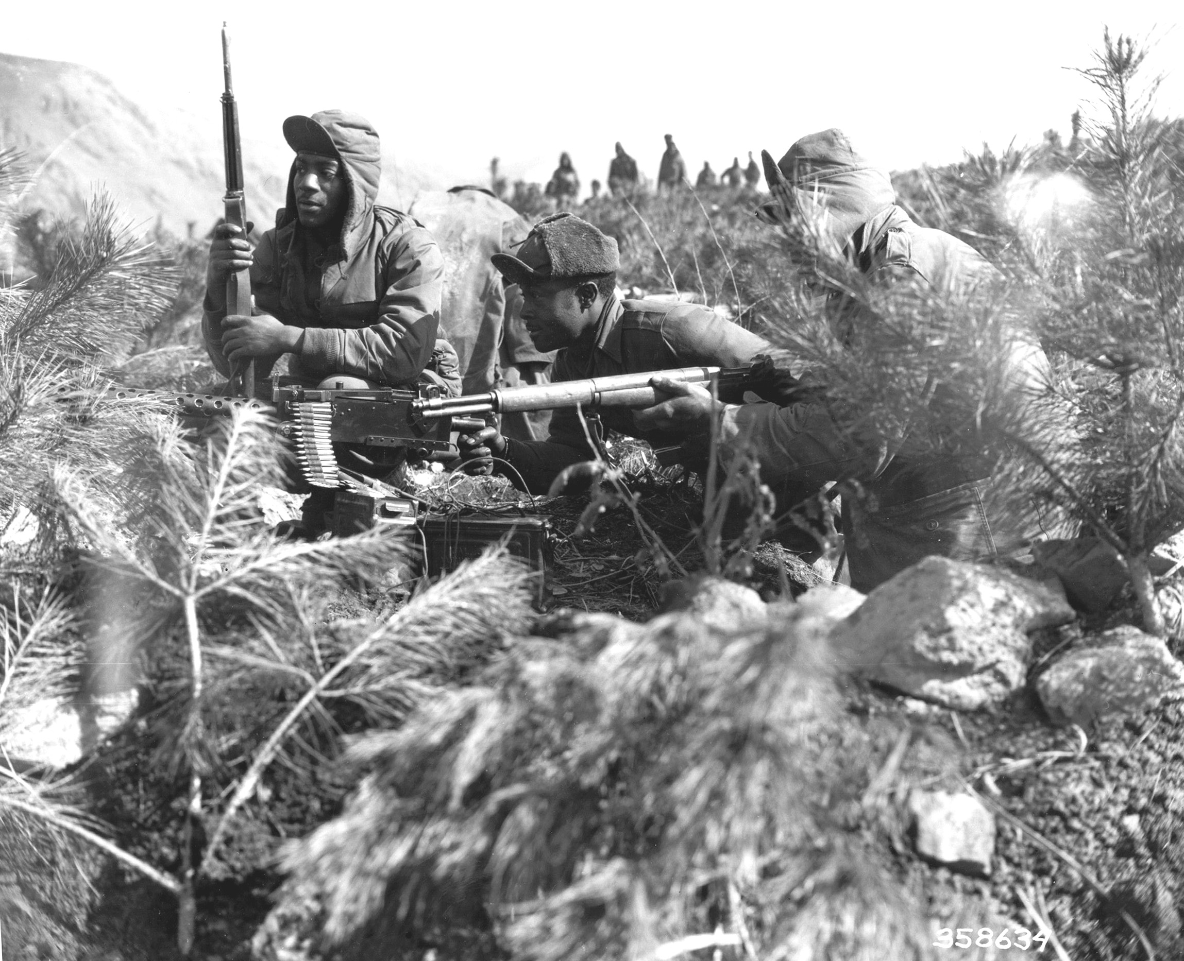
The Road to War
End of World War II
-Time for Peace
-United Nations
-Korea Under Japan’s Rule
-Invasion of South Korea by North Korea
-Soviet Union establishes Communist Government in North Korea
US and USSR
-Japan’s Defeat
-Division of Korea
-Soviet Union

Slide 5
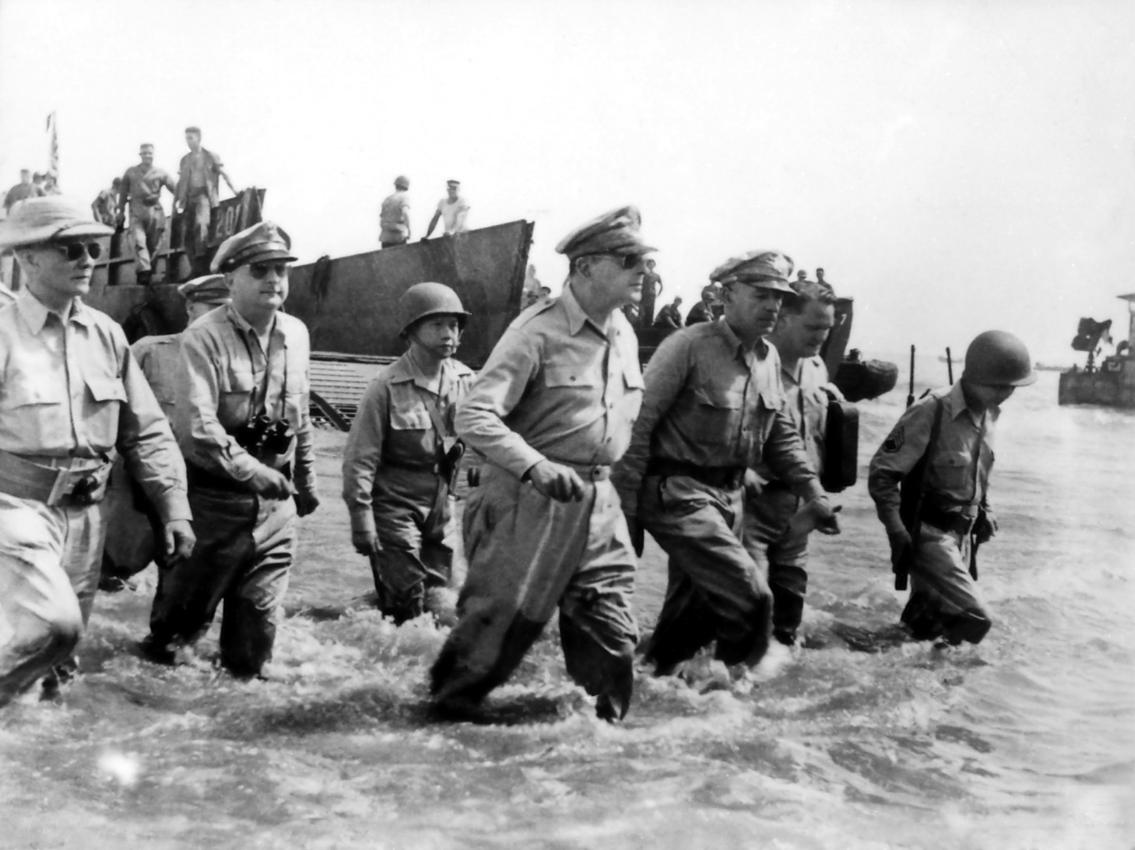
Key Players
General Douglas MacArthur (January 1880-April 1964)
an American general and Field Marshall of the Philippine Army
Chief of Staff of the United States Army during 1930’s
Medal of Honor Recipient for service in Philippine campaign
Army’s youngest Major General
Led United Nation ground forces mainly consisted of U.S. Marines during Battle of Inchon
Dean Acheson (April 1893 – October 1971)
American Statesman and Lawyer
Convinced President Truman to intervene in the Korean War (1950)
Selected as Truman’s under secretary of United States Department of State
Song Shi-Lun; Led 67,000 Chinese troops during Battle of Chosin
Kim Il Sung; Leader of North Korea, wanted Korea united as Communists
Mao ZeDong; Communist China Chairmen, Brutal Dictator
Democratic People’s Republic of Korea
People’s Republic of China
Union of Soviet Socialist Republics

Slide 6
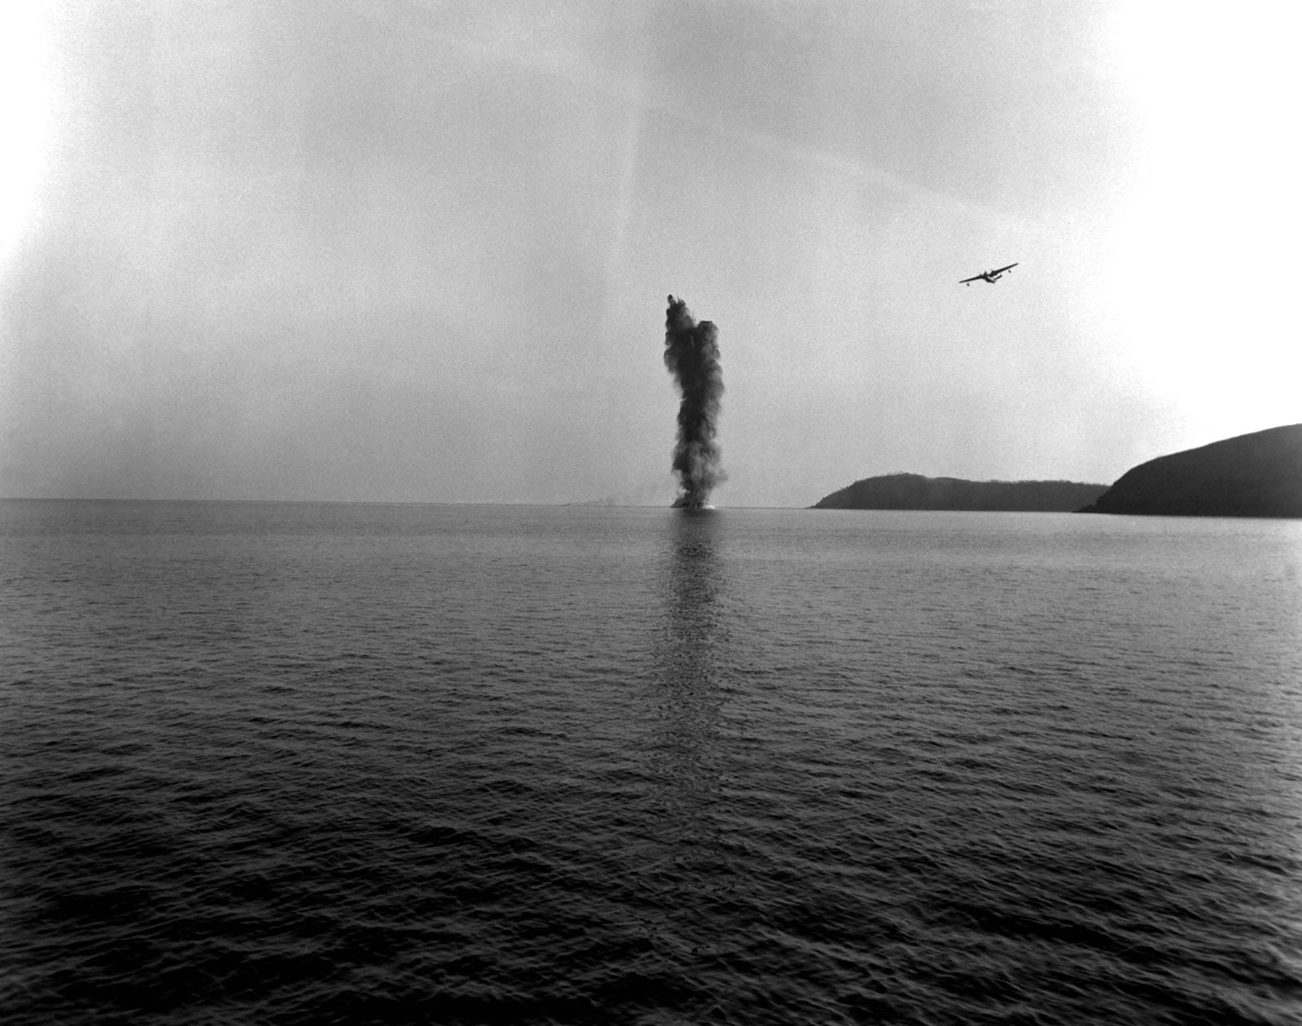
Timeline for War
DATES OF CONFLICT:
BEGAN: June 25, 1950
ENDED: July 1953
Aug. 6 - Sept. 12, 1950
Defense of Pusan Perimeter. After a series of costly delaying actions during July, the U.S. Eighth Army withdrew on Aug. 1 into a final defensive line around the key port city of Pusan. After deploying from Japan the previous month, Eighth Army had assumed command of all U.S., ROK, and other nations’ ground combat units fighting to defeat the North Korean invasion. As reinforcements from the United States and several other nations arrive at the port, Eighth Army directed the successful defense of the perimeter against major NKPA attacks in August and September
Sept. 15, 1950
X Corps amphibious assault at Inchon, Seoul’s port city. General of the Army Douglas MacArthur, commander-in-chief of Far East Command and commander-in-chief of United Nations Command, plans to liberate Seoul and crush the NKPA between X Corps and Eighth Army begins its breakout from the Pusan Perimeter on Sept. 16.

Slide 7
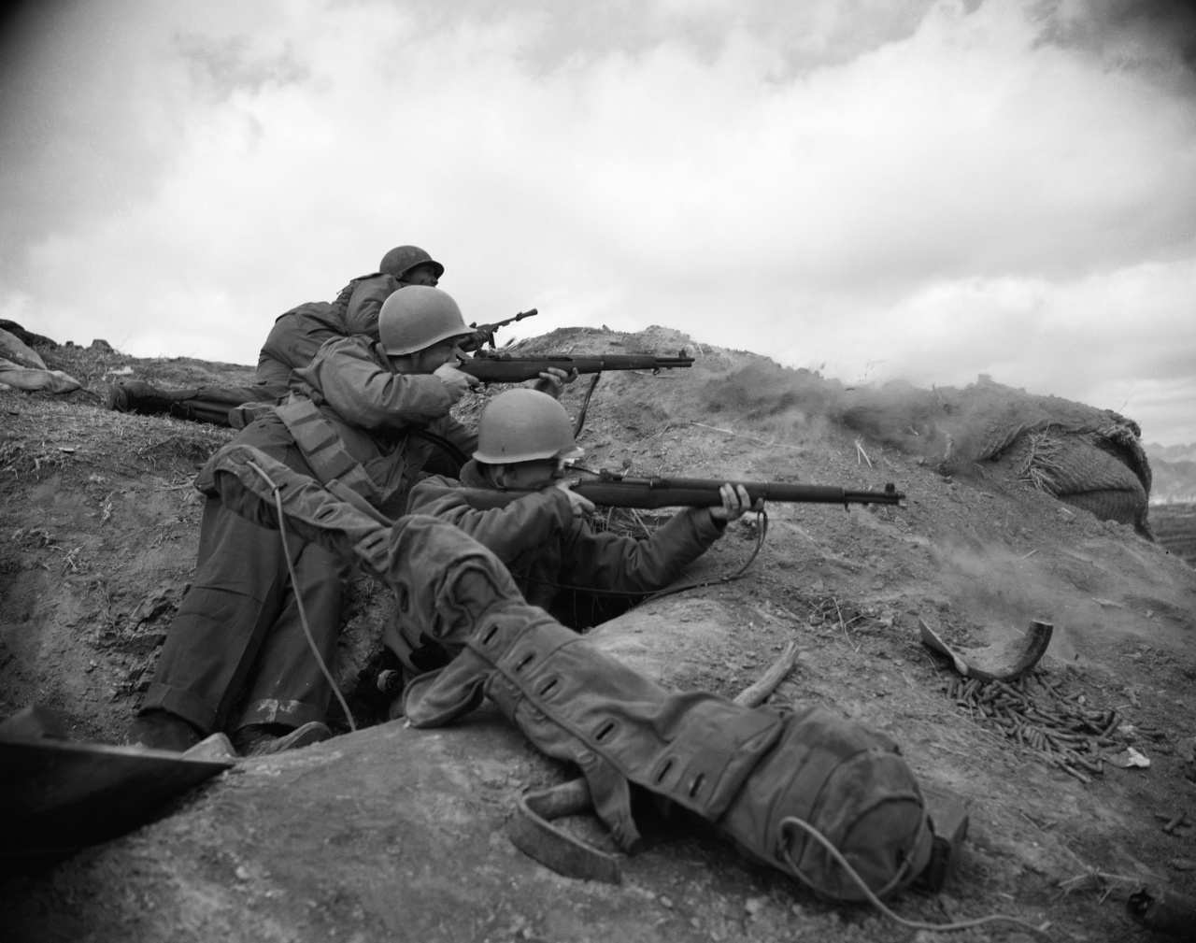
Battle Focus
Some of the many battles the Korean War include the battles of Inchon, Pusan, and Chosin.
The battle of Inchon was codenamed "Operation Chromite".
Amphibious Landing involved some 75,000 troops and 261 naval vessels.
This battle ended in several victories over the North Koreans Peoples Army and the recapture of Seoul.
The next battle, Pusan, was a large-scale battle between the forces of the U.N. and the North Korean forces which lasted from August 4 to September 18, 1950
An army of 140,000 U.N. troops were rallied into a final stand against North Korean forces, which were 98,000 men strong.
U.N. troops were forced back to the Pusan Perimeter, a 140 mile defense line.
The U.N. troops, mostly consisting of the Republic of Korea Army, United States Army, and British Army held back North Korean forces for six weeks
After these six weeks the North Korean forces retreated.
The battle of Chosin lasted from November 27 to December 13, 1950
When the People's Republic of China forces entered the conflict, the People's Volunteer army infiltrated the North Eastern part of North Korea and surprised the U.S. X Corps, a brutal 17 day battle in freezing weather followed.
. During this time 30,000 U.N. troops led by Major General Edward Almond were nicknamed "The Chosin Few".
These "Chosin Few" were encircled by 67,000 Chinese troops, though outnumbered, the U.N. managed to escape the encirclement and inflicted crippling losses to the Chinese. The evacuation of the X Corps marked the full withdrawal of the U.N. forces.

Slide 8
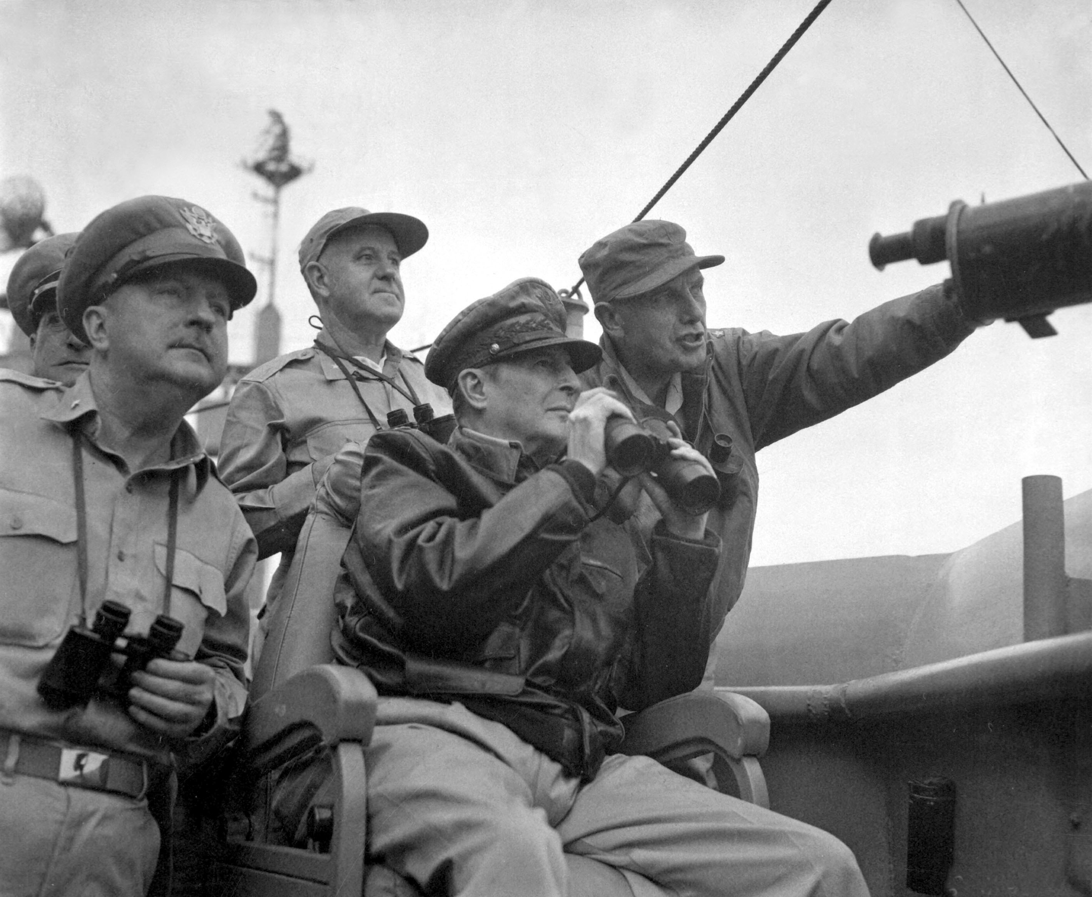
Mission and Operations
The Purpose of the Korean war was to prevent the spread of Communism. Much like the Vietnam War
Kim Sung, the leader of the communist North Koreans, declared war at 11:00 a.m. on June 25, 1950, approximately 7 hours after his forces crossed the 38th parallel into South Korea
Kim Sung’s goal was to unite the Korean Peninsula under the rule of the Korean Communist Party while South Korea was fighting for democracy
The objective of the United States was to push the invaders back across the 38th Parallel
Doing so the US hoped to stop the spread of Communism in Asia
The Soviet Union did not take an active part in the hostilities but they did supply equipment to the North Koreans
Their purpose was probably to observe US doctrine and hope for a weakening of the US, militarily, politically and economically.
Operations
Chromite (1950)- US invasion at Inchon
Little Switch (1953)- Exchange of sick and wounded prisoners of war between United Nations and North Korean/Chinese forces.
Ripper- (1951)- UN movements towards the 38th parallel to recapture Seoul

Slide 9
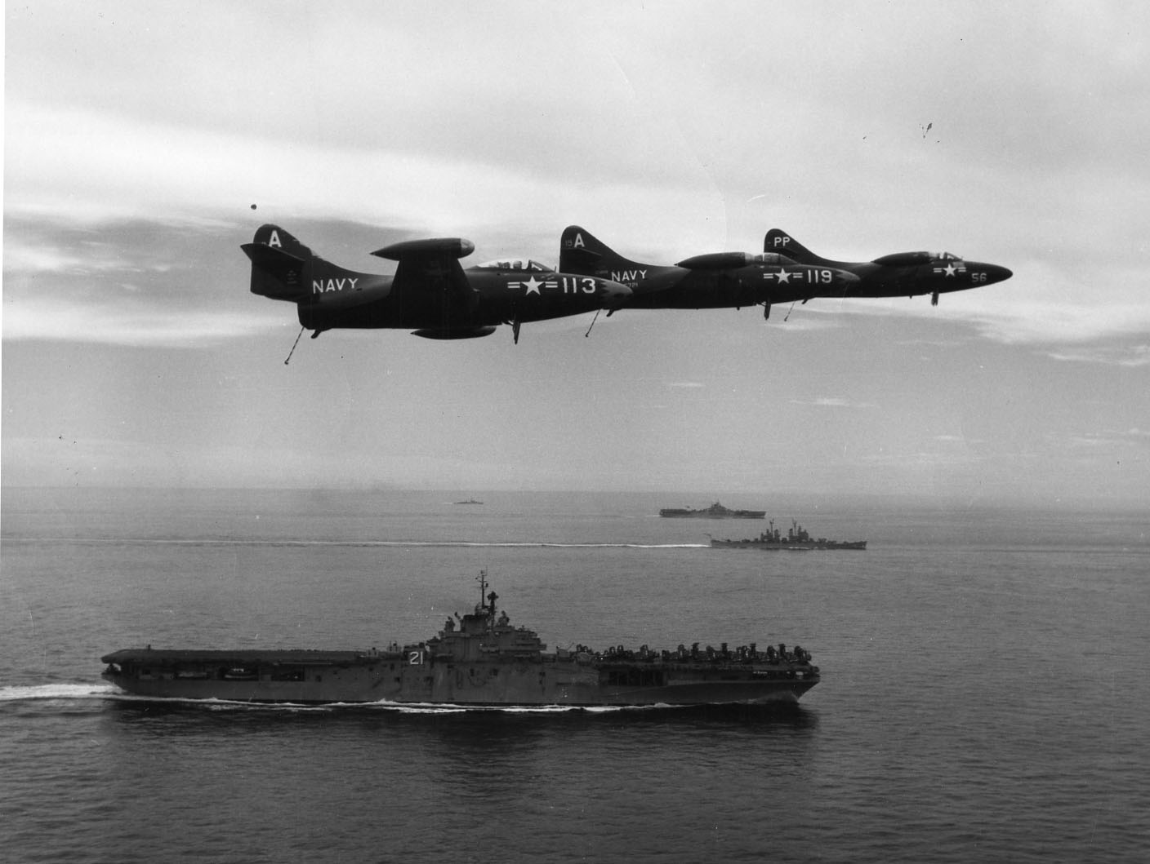
Equipment and Innovations
Same weapons as World War II
Sioux Helicopter
The Bell UH-1 Iroquois
T-34
Upgraded M4 Shermans, M26 Pershings, and M46 Pattons
First use of jet aircraft such as the: F-86 Sabre, P-80SS, F9F Panther, and the MiG 15

Slide 10
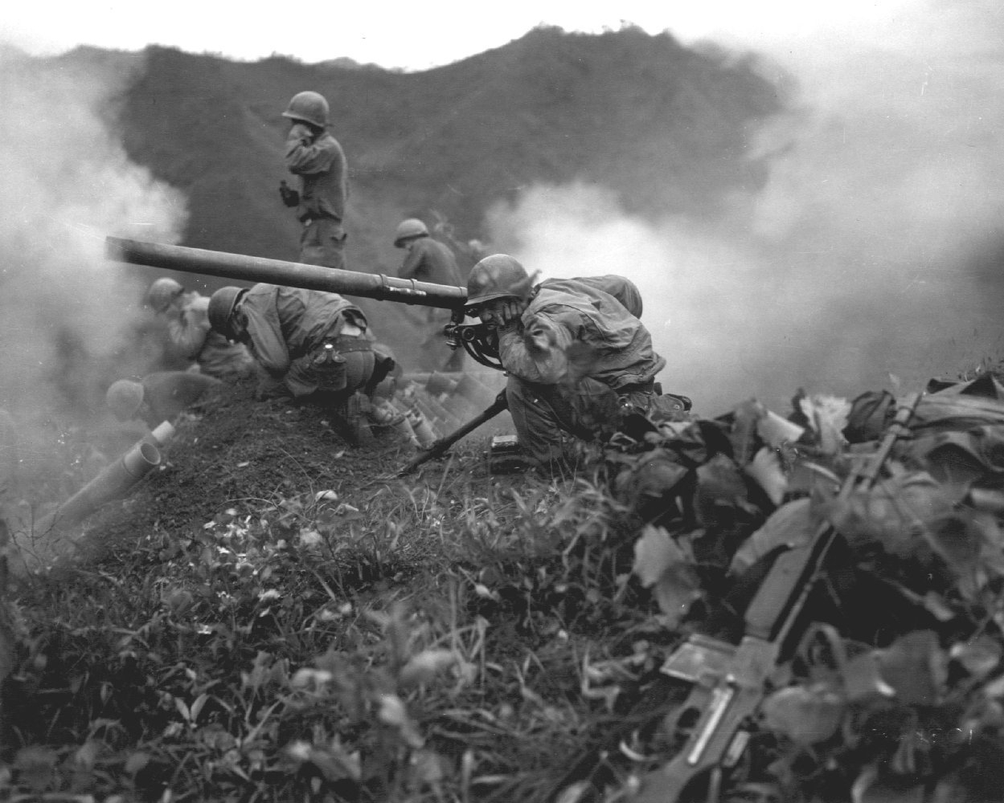
Intelligence
Enemies of Korean War:
Democratic Peoples Republic of Korea
People’s Republic of China
Union of Soviet Socialist Republics
Allies in Korean War:
Japan Canada
United States Turkey
United Kingdom Australia
France Netherlands
Kingdom of Greece Colombia
Thailand Ethiopian Empire
Philippines Belgium
Union of South Africa New Zealand
Norway Luxembourg
Kim Il Sung (15 April 1912 – 8 July 1994)
Syngman Rhee (March 26, 1975 – July 1965

Slide 11
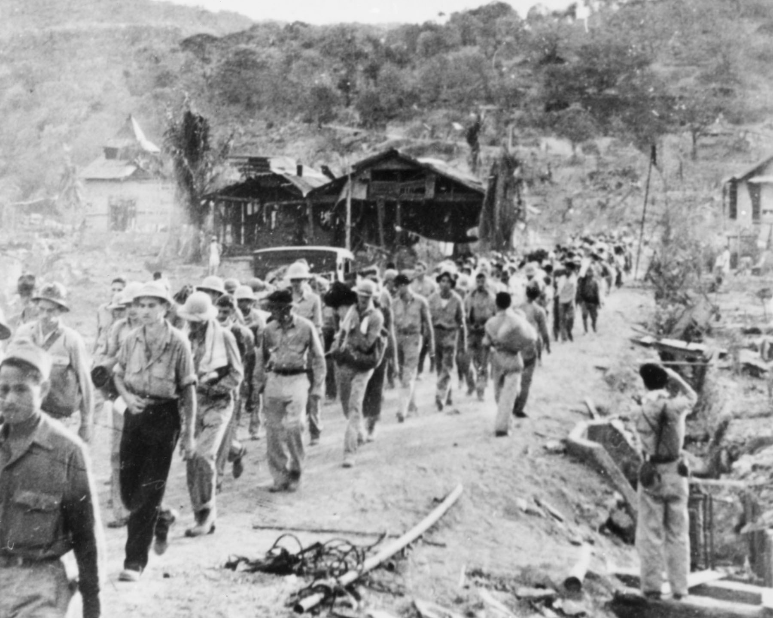
Enemy Description
Song Shi Lun
Kim Il Song
Mao Tse Tung
North Korea supported by USSR and China
North Koreans used Soviet T-34-85 medium tanks that dominated the battlefield
Korean People’s Air Force equipped with MiG-15 Fagots (one of the worlds most advanced jet fighters)
Committed War crimes (Civilian deaths and massacres)
Mistreated Prisoners of War by means of execution, continuous labor, starvation, and even marching to death

Slide 12

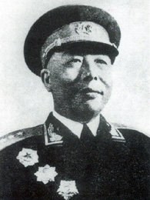
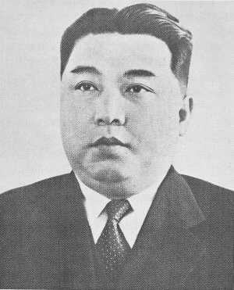
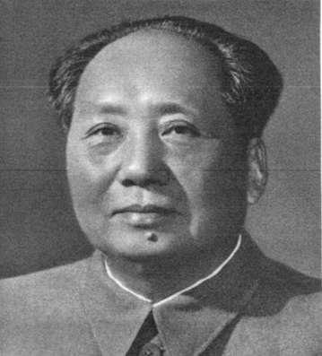
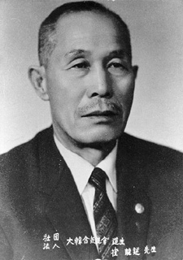
North Korean Leaders
Song Shi Lun
Kim Il Sung
Mao Tse Tung
Choi Yong-kun

Slide 13
End State
The United Nations Command, supported by the United States, the North Korean People's Army, and the Chinese People's Volunteers, signed the Armistice Agreement on July 27, 1953 to end the fighting.
About 100,000 North Koreans were executed in internal communist party purges.
Forced labor and concentration camps were responsible for over one million deaths in North Korea, others have estimated 400,000 deaths in concentration camps alone.
According to the data from the US Department of Defense, the United States had suffered 33,686 battle deaths, along with 2,830 non-battle deaths during the Korean War and 8,176 missing in action.
Between some 245,000 to 415,000 South Korean civilian deaths were also suggested, and the total civilian casualties during the war were estimated as 1,500,000 to 3,000,000
General MacArthur wanted to win the war by invading China. President Truman disagreed as this action could spark World War III and going to war with China would be the wrong war, in the wrong place, at the wrong time, with the wrong enemy.
General MacArthur was then relieved for insubordination.

Slide 14
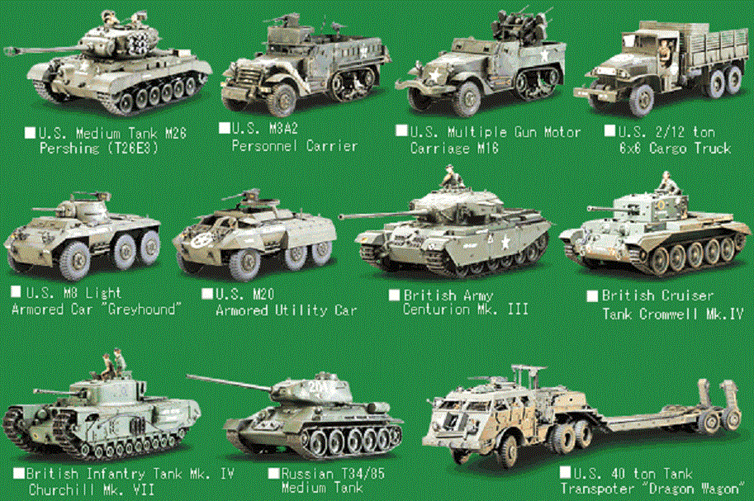

Slide 15
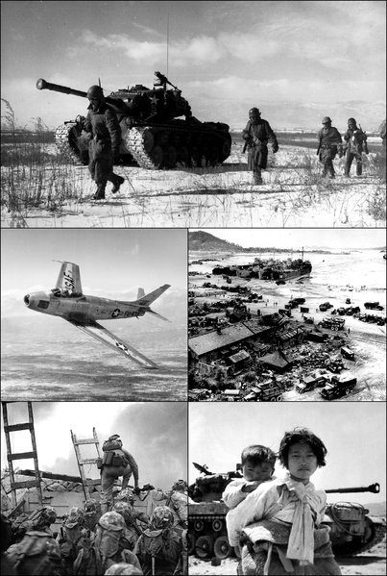
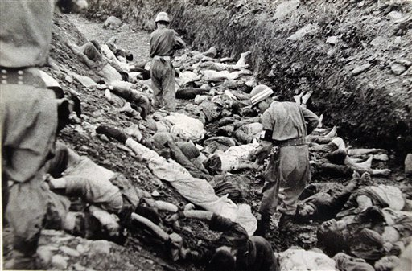
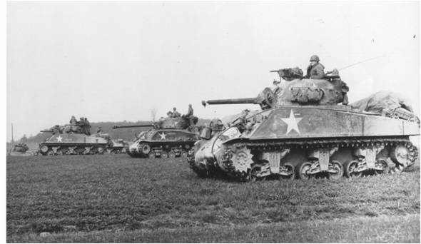
Whoops

Slide 16
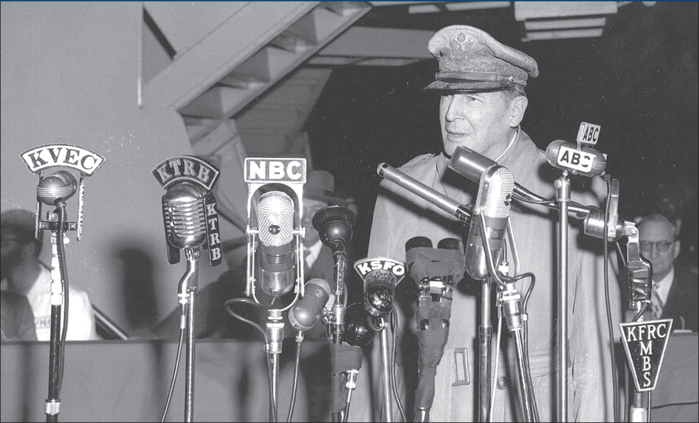

Slide 17
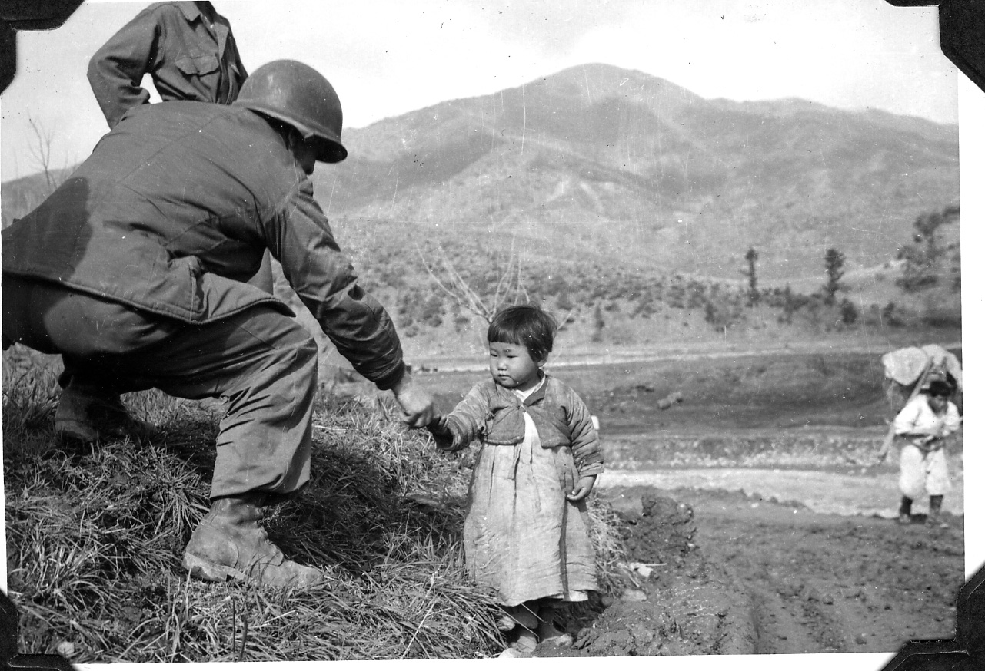

Slide 18
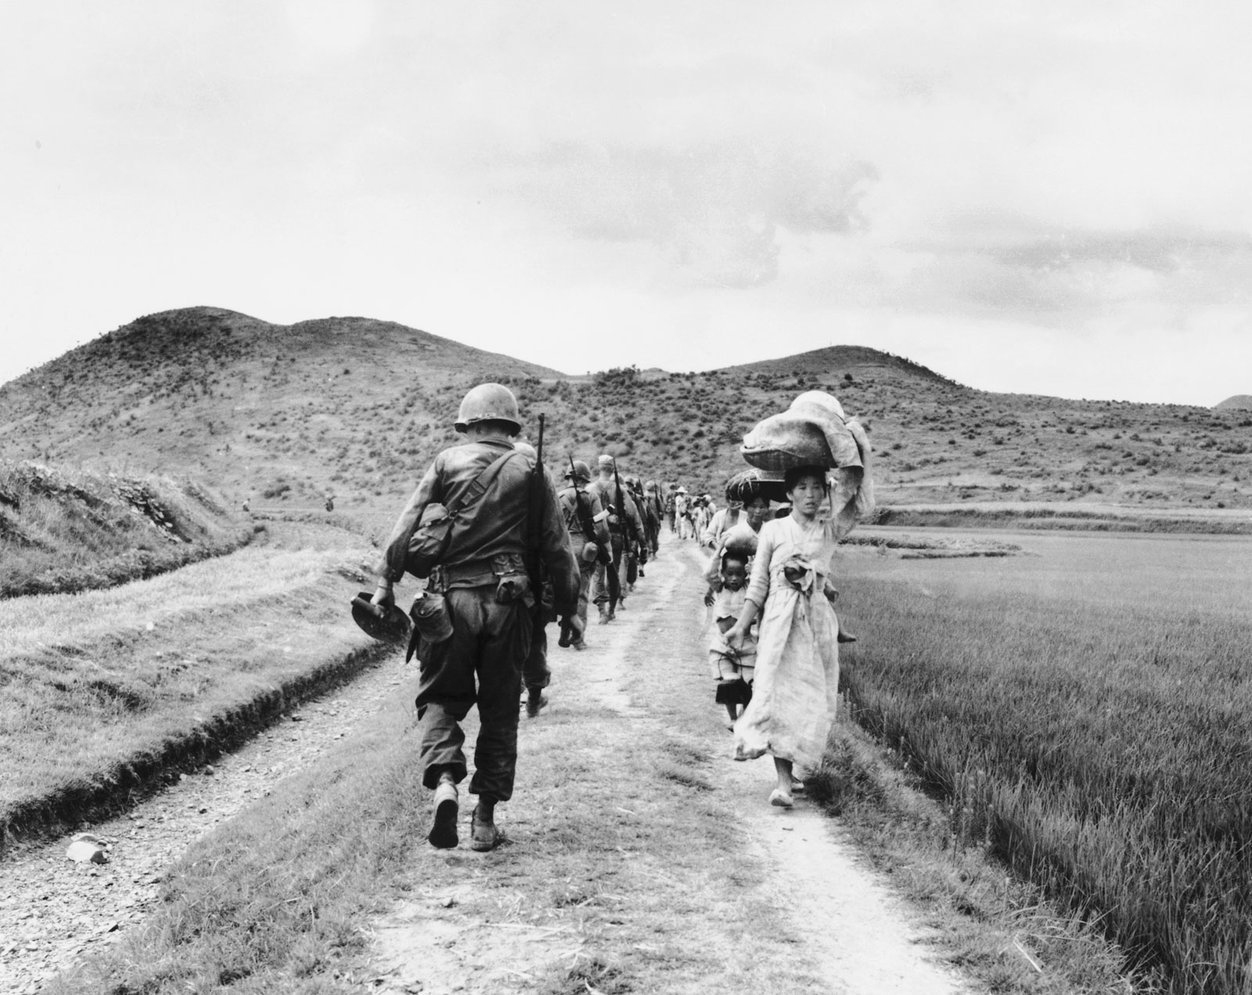
The End

Slide 19


